Slide 1
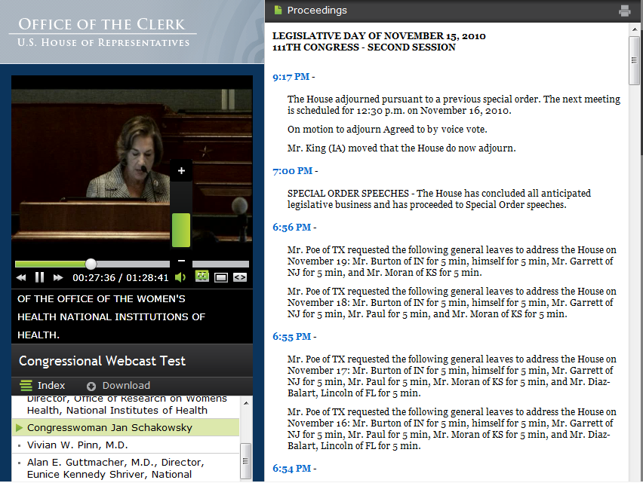
Improved Public Video Player

Slide 2
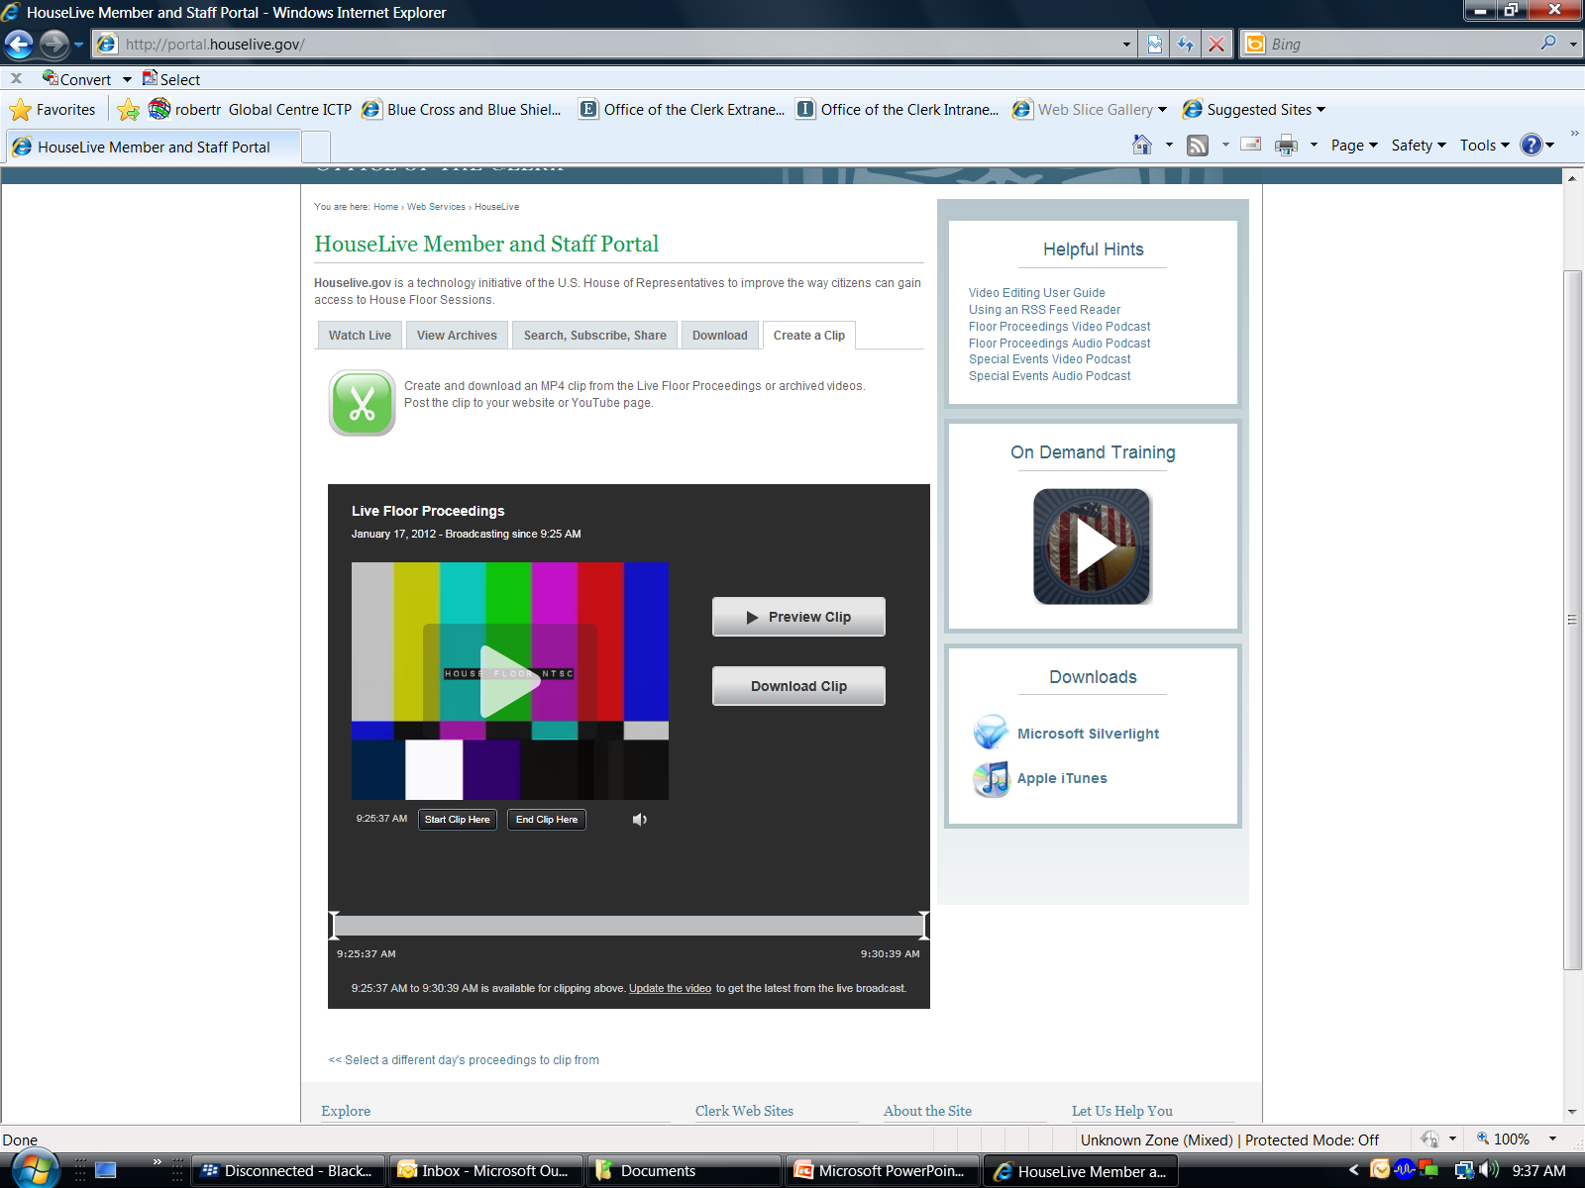
Live and Archive Video Clipping

Slide 3
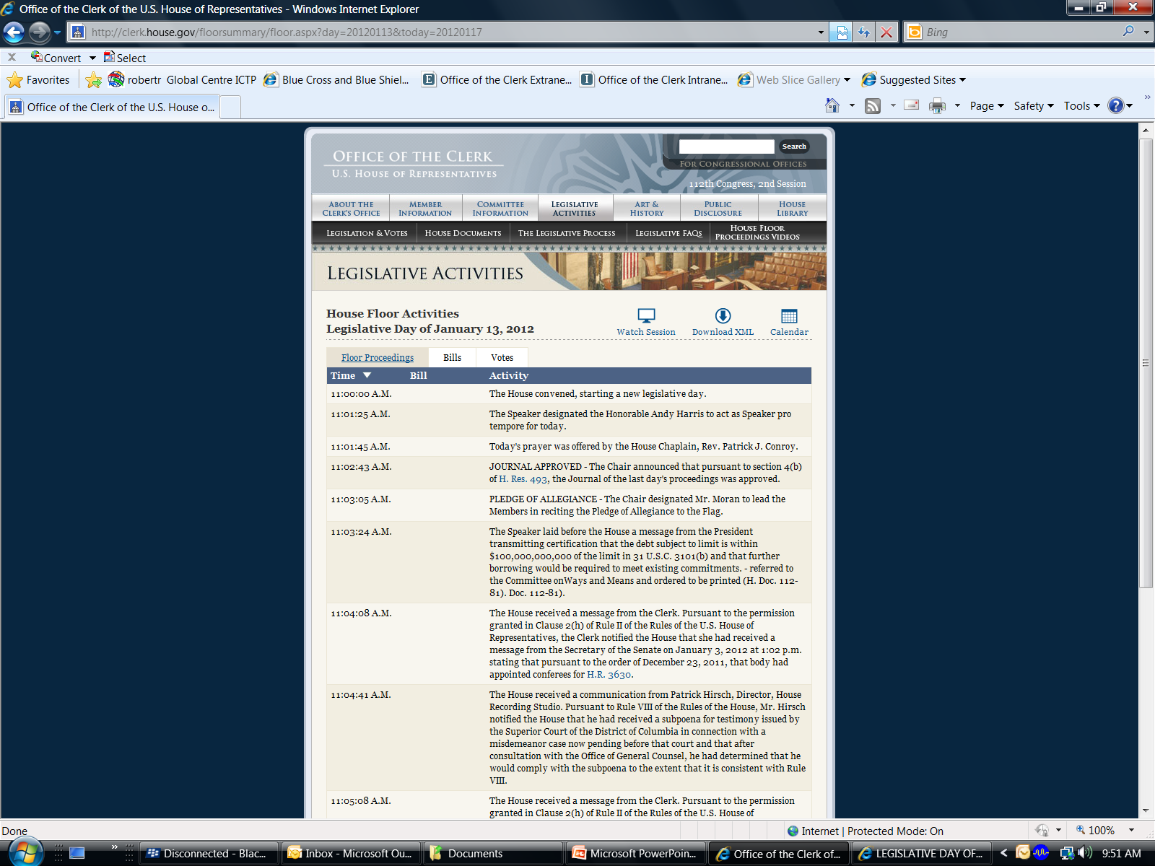
New House Floor Activities Page

Slide 4
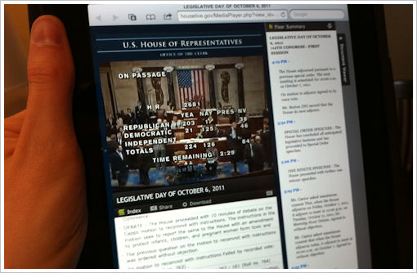
Houselive on Mobile Devices

Slide 5
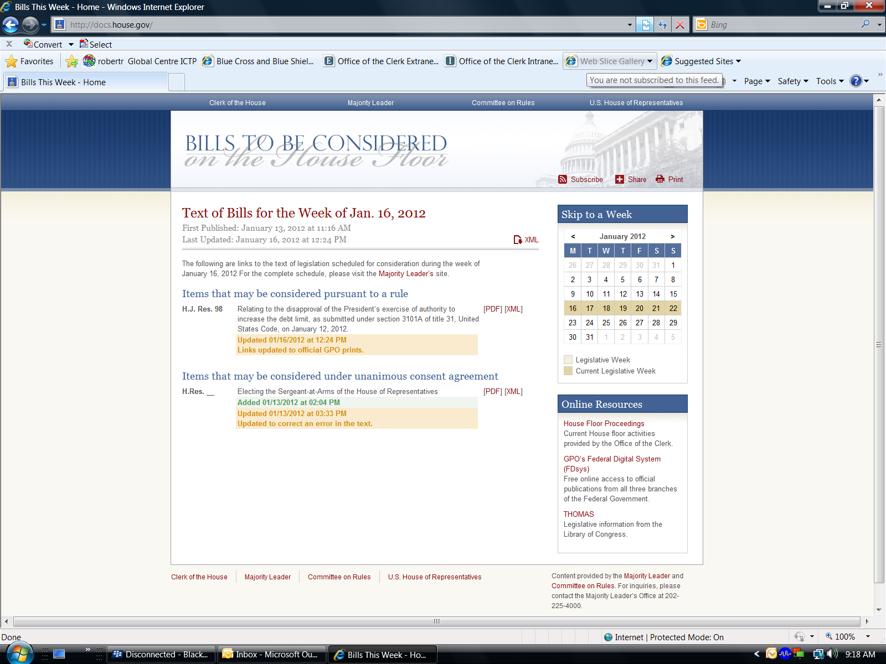
2012 Clerk Web Updates

Slide 6
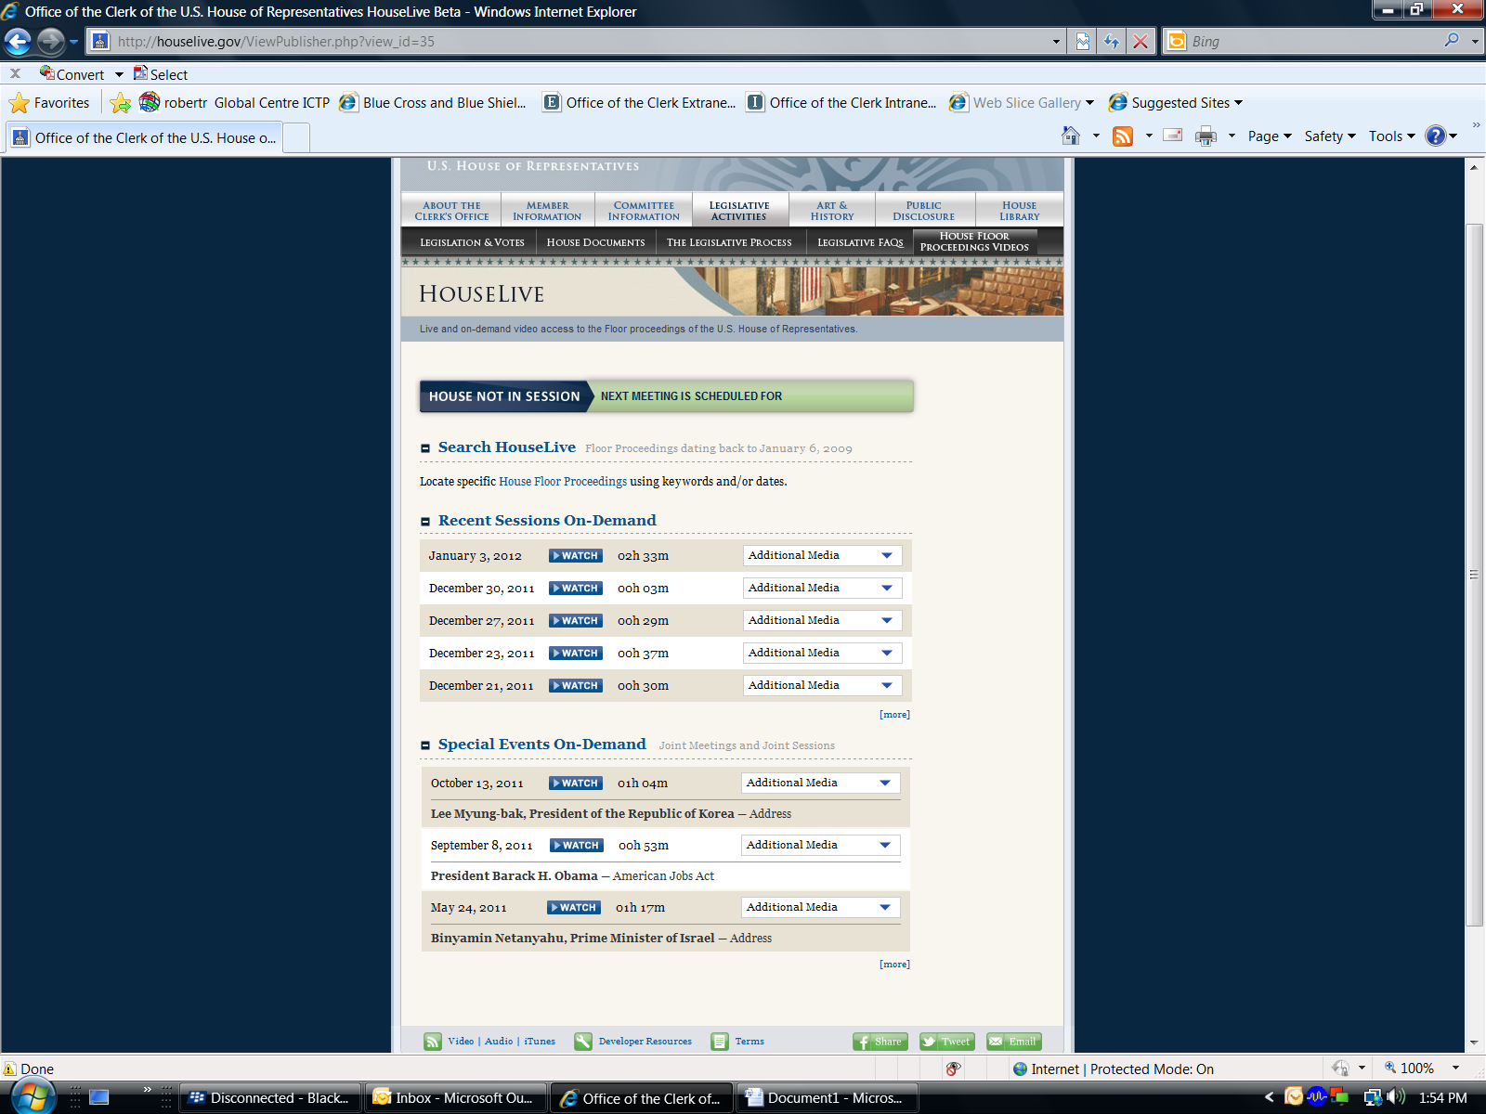
Planned 2012 Houselive Updates

