Slide 1

Government Printing Office
The mission of GPO is to produce, preserve, and distribute the official publications and information products of the Federal Government.

Slide 2
Composition
eXtyles
  Transform Word to XML
XMetal
  Author structured data
InDesign CS5.5
  Create multi-channel publications
AutoBatch
  OCR scanned tables in the Record

Slide 3
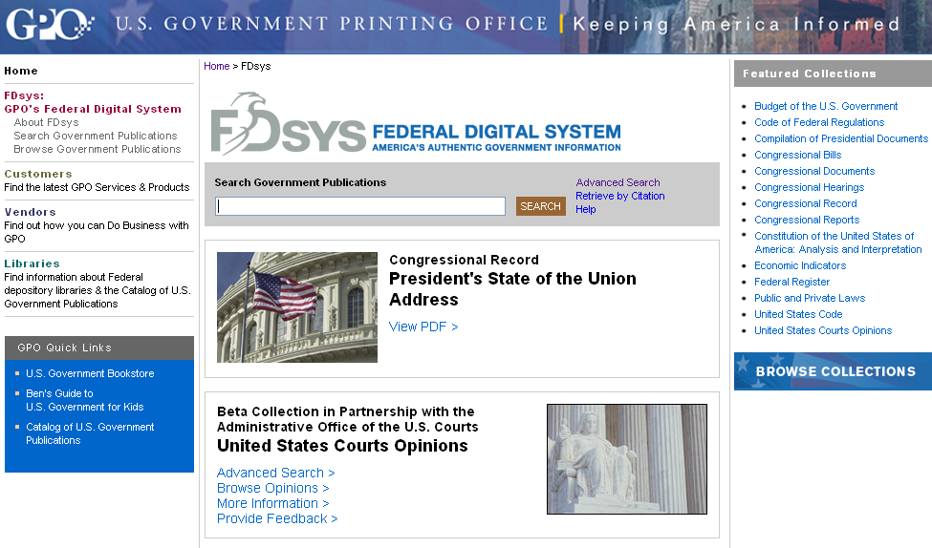

Public Access via FDsys
Content management system, preservation repository, and public access site
Launched in 2009 and replaces GPO Access
Search and browse
six million documents
Contains authentic Federal Government information

Slide 4
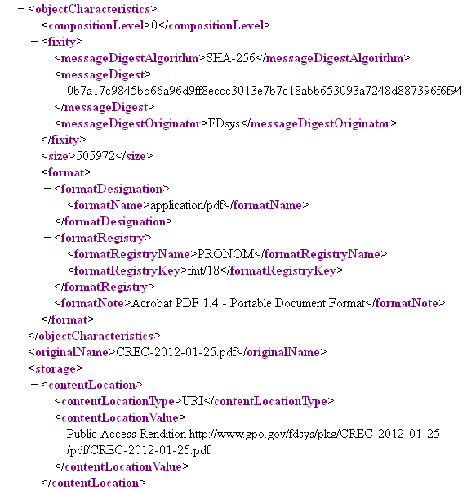
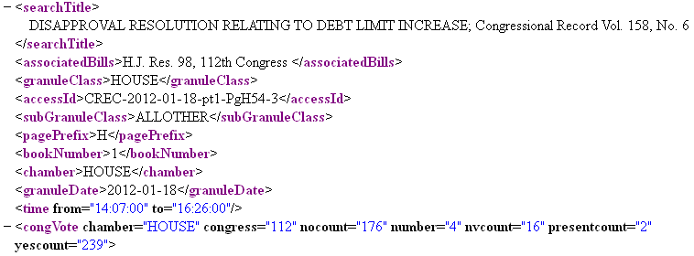
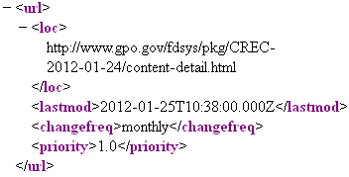
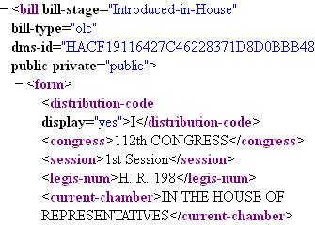
Data Transparency Features
PREMIS XML Includes Message Digest for Each Content File
MODS XML Includes Descriptive Metadata for Each Content File
Site Maps Enable Crawling and Caching
Amount of XML Content Increasing

Slide 5
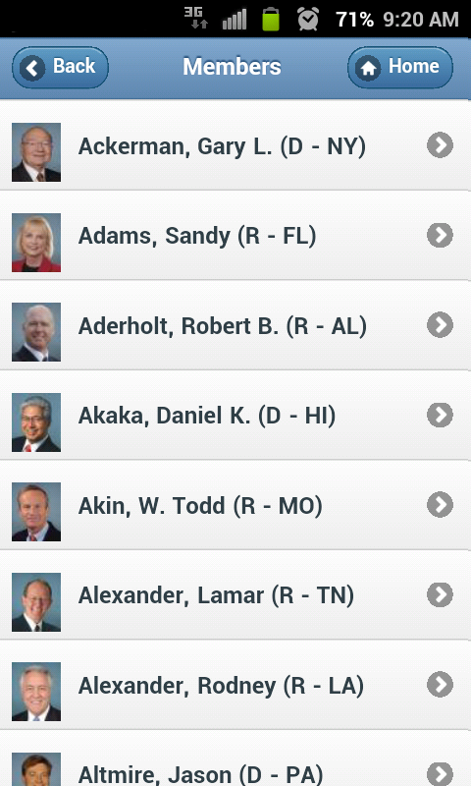
Public Access Initiatives
Enhancing GPO’s Mobile Member Guide web app with biographical and contact information
Collaborating with other Government agencies on additional web apps
Planning an FDsys API to support app development and data transparency
Creating files and metadata for individual public laws in the digitized Statutes at Large
Collaborating with the LC to digitize and provide public access to the permanent volumes of the Congressional Record from 1873-1998
Expanding the number of titles available as eBooks through Google’s eBookstore

Slide 6
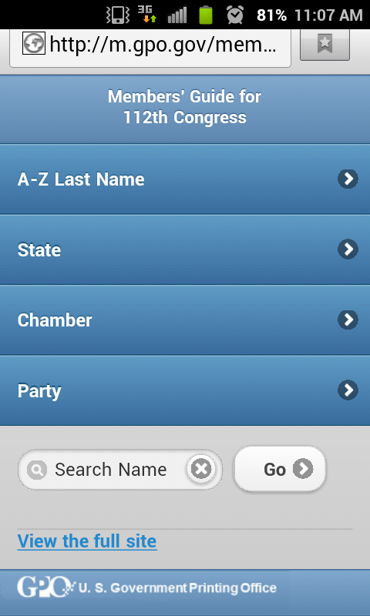
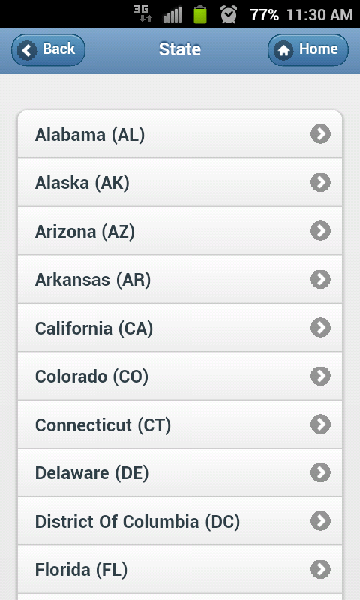
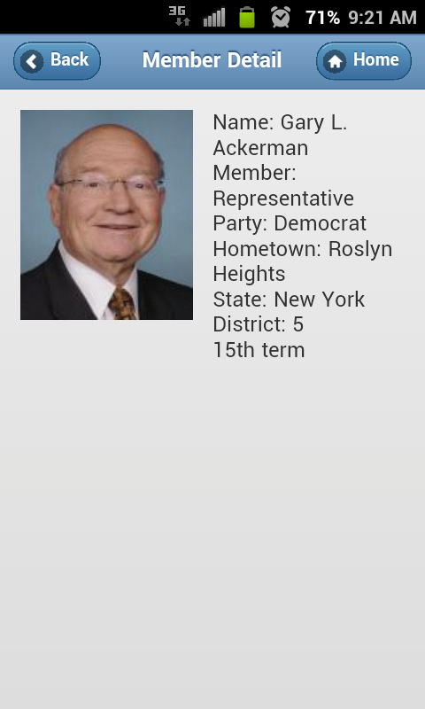
Mobile Member Guide

