Slide 1
A Recipe for
Electronic Citations
by Martha Stewart Daniel Bennett

Slide 2


Current Open Standard Effort
OASIS Legal Citation Markup (LegalCiteM) TC
https://www.oasis-open.org/committees/tc_home.php?wg_abbrev=legalcitem

Slide 3
Current Open Standard Effort
OASIS Legal Citation Markup (LegalCiteM) TC
Subcommittees
Adjudications of Courts, Court Documents, and Court/Tribunal Rules SC
Executive Branch/Regulations/Administrative Documents SC
Legislation, Constitutions, Treaties and Parliamentary Documents SC
Secondary Material SC
Technical SC

Slide 4
Current Open Standard Effort
OASIS Legal Citation Markup (LegalCiteM) TC
Technical Subcommittee
Wiki DRAFT
https://wiki.oasis-open.org/legalcitem/FundamentalRequirements2nd
Vocabulary
Features
A layered model of documents

Slide 5
citation: an explicit, plain-text, human-readable mention of a legal document (or a fragment thereof)
reference: a machine-readable representation of a citation
identifier: a string univocally associated to a document (or a fragment thereof) to identify it.
locator (also URL): a string containing instructions (e.g. protocol, address, filename) that can be used to access a resource.
resolution: the action of determining the Locator best matching the information specified in a reference. resource: the thing being cited.
dereference: the action of delivering a copy of the resource specified by the locator, for example, by traversing a link to deliver a copy to the requesting application.
navigating: A complex action on a reference, composed of two parts: the resolution of the reference into a locator, and the dereference of such locator into a copy of the document meant by the reference.
Vocabulary

Slide 6
The citation contains information that are used by the creator to describe the cited document in a manner that allows a (possibly expert) reader to identify it. Most often this is done by the specification of data associated to properties that are unique to such document. For instance, in
42 U.S.C. § 405(c)(2)
we can identify values for several properties:
U.S. identifies the country United States
C. identifies the document Code of the United State
42 identifies the 42nd title of the US Code
405 identifies the 405th section of title 42 of the US Code
(c) identifies the third paragraph of section 405 of 42 U.S.C.
(2) identifies the second clause of paragraph c of § 405 of U.S.C.
....
features

Slide 7
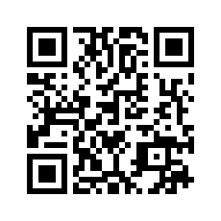
Consider FRBR: Functional Requirement for Bibliographic Record
The Work
The Expression
The Manifestation
The Item
//Helpful Document explaining FRBR
//http://www.loc.gov/cds/downloads/FRBR.PDF
A layered model of documents

Slide 8
Potential Future Uses of Citations
Machine readable document layers possible with human presentable HTML using HTML5 Microdata
UID - Universal ID/ Citation Locator for documents and data to be used for any database or within a metadata package/standard

Slide 9

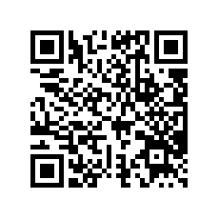
Layered Doc or
Stack of Flapjacks?
Martha Stewart’s
Buttermilk Pancake Recipe
http://www.marthastewart.com/318689/best-buttermilk-pancakes

Slide 10
Example: Recipe
Recipe
  URL/location
  Name
  Description
  Recipe Yield
  Image
  Ingredients
  Recipe Instructions

Slide 11
Example: Recipe
Recipe ( itemtype="http://schema.org/Recipe" )
  URL/location ( itemprop="url" ), http://www.marthastewart.com/318689/best-buttermilk-pancakes
  Name ( itemprop="name" ), Best Buttermilk Pancakes Recipe
  Description ( itemprop="description" ), the secret to fluffy buttermilk pancakes
  Recipe Yield ( itemprop="recipeYield" ), Makes nine 6-inch pancakes
  Image ( itemprop="image") ,
  Ingredients ( itemprop="ingredients" ), 2 teaspoons baking powder...
  Recipe Instructions ( itemprop="recipeInstructions" ), ....
Note the key pair values that Microdata allows/embeds into HTML.

Slide 12
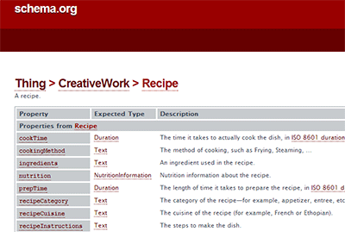
Example: Recipe

Slide 13
UIDs Using Cite Locators
Using electronic cites outside of legal documents created by government:
Newspaper articles
Policy papers
Constituent correspondence
Data e.g. with health privacy issues, HIPAA
Regulated systems to allow auditing

Slide 14
contact info
Daniel Bennett
daniel@citizencontact.com

