Slide 1
house.gov/404
Derek Willis, The New York Times
dwillis@nytimes.com

Slide 2
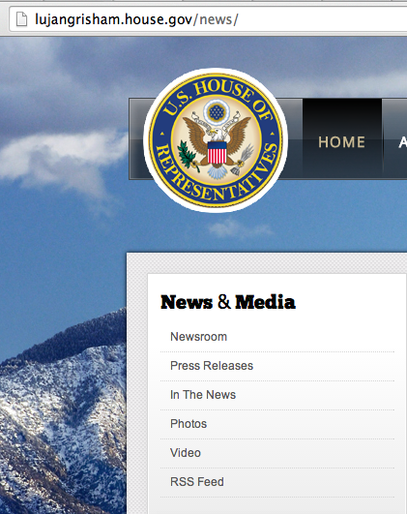

Slide 3
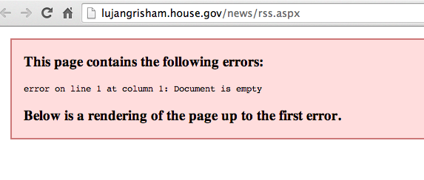
Document is empty

Slide 4
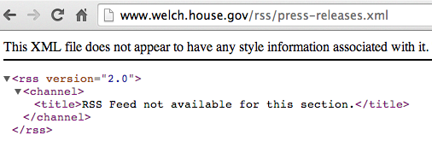
Slightly better, I guess

Slide 5
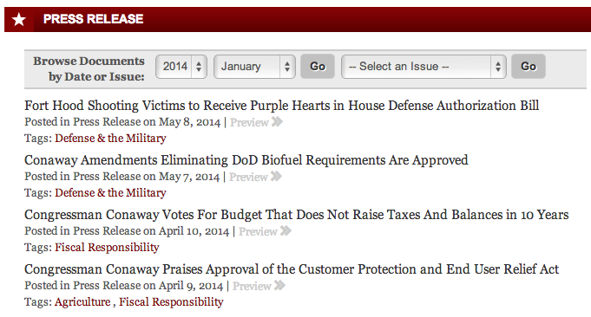
My sworn enemy

Slide 6
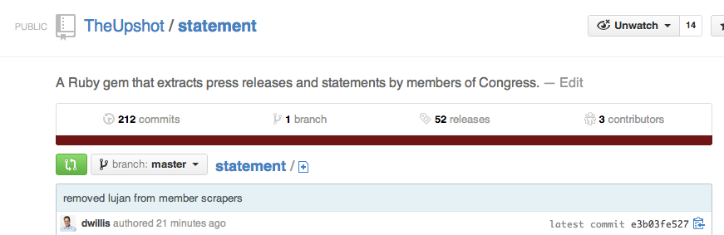
The response

Slide 7
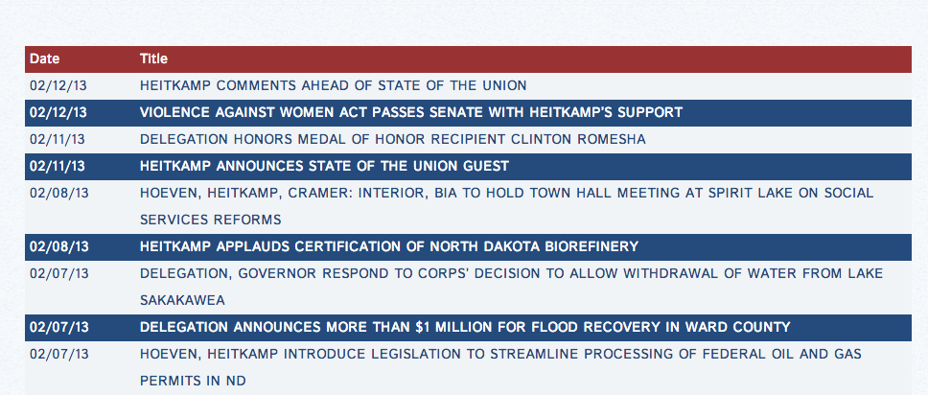
It could be worse

Slide 8
Some suggestions
Use RSS. It works.
If RSS link is 404, make it xml
Please don’t use relative dates (11/10)
Change the CSS all you want. Don’t change URLs.

