Slide 1
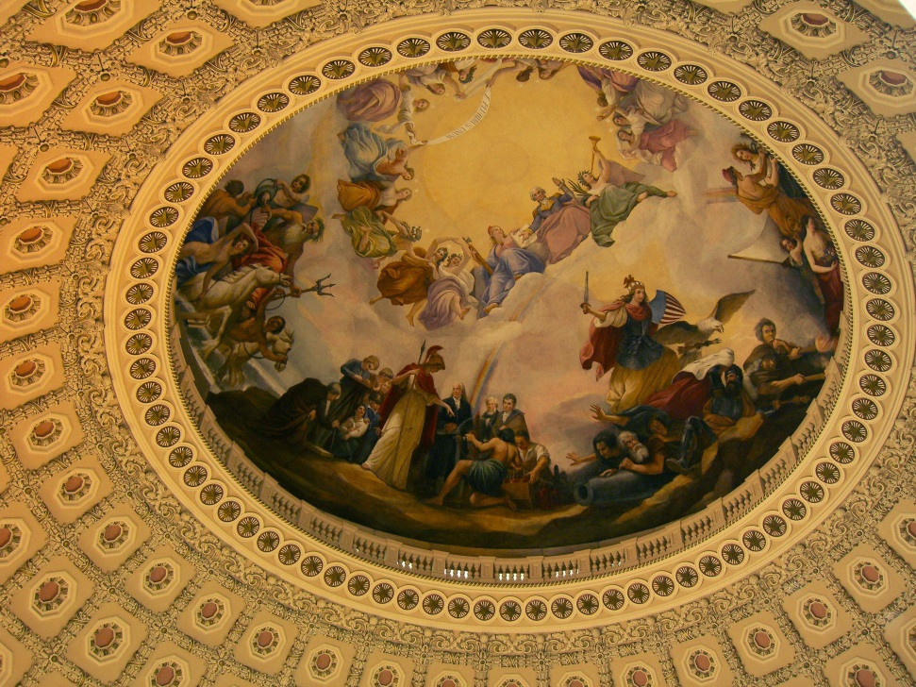
MODERNIZATION INITIATIVE
OFFICE OF THE LEGISLATIVE COUNSEL OF THE HOUSE

Slide 2
Compilation Migration
Migrating all compilations of laws, an accurate database of current laws, from bell code to XML
Allows rapid updating of compilations
Availability of compilations on office website

Slide 3
Drafter’s Toolkit
The “mini-Ramseyer” program, which can show the changes to existing law made by a bill; the database of laws has to be accurate; it will be composed of those titles of the US Code that have been enacted into law; and the underlying statutes appearing in the remaining titles of the US Code.
Additional features: jump to statute; creating amendatory instructions from compilations.

Slide 4
Legislative Lookup and Link
A program that would link references to provisions of law occurring in any of a number of formats (Word documents, emails, bills) directly to those provisions of law from sources within and outside of HOLC
The user interface(s) will be functionally separate from the lookup mechanism, so that LLL can be used with a variety of devices and contexts.

Slide 5
Additional Projects
Information Management-
Track changes----
Program to improve tracking of our office work flow
Program to allow markup of compilation to create amendatory bill

Slide 6
AMENDMENT IMPACT PROGRAM
Shows how amendment to a bill or other “base document” will impact that document
Will improve the accuracy of drafting
Will allow Members to readily see how a bill will read with inclusion of a proposed amendment
Will allow committees to more quickly assess the impact of proposed/pending amendments

