Slide 1
Federal Legislative Information Flow
Kirsten Gullickson,
Sr. Systems Analyst
Office of the Clerk
Notes:
Hi, My name is Kirsten Gullickson. I am a systems analyst with the House Office of the Clerk.
[Thanks to ___ for introducing me, …..etc. etc.]
As many of us know, the House is engaged in an on-going effort to author and publish its official documents and data in XML. The goals of this effort are to make improvements in the cost, accuracy, timeliness and efficiency of the document creation and revision process, as well as establish common data standards for the exchange of legislative information with the Legislative Branch organizations.
My part of the day is to share with the group where and how our documents and data are exchanged between these Legislative Branch organizations.
Before I do that, I want to take some time to review the institutional challenges that are faced, not only by the United States Congress, but by parliaments and legislative bodies around the world.

Slide 2
The Challenge
Legislative documents and related data must be
prepared
managed,
distributed, and
archived.
This includes paper and electronic means for handling the official documents.
Notes:
When dealing with legislative documents and data, legislative bodies -- such as the U.S. Congress, the British parliament, our local county commission -- must be concerned with preparing, managing, distributing and archiving activities. This includes paper and electronic means for handling the official documents of record. For the U.S. House and Senate, the paper copy is the official document of record.

Slide 3
The Challenge (cont’d)
Government data must be
Accurate
Accessible
Complete
Detailed
Searchable
Notes:
In addition, government data must be accurate, accessible, complete, detailed, and searchable.
What does this all mean when building systems that meet the needs of Members of any particular parliament or legislative body, their staff, and the public?

Slide 4
ICT Systems
Systems to create, manage and distribute legislative data and documents must be--
quick,
flexible,
meet the changing needs of the public and the members of parliaments, and,
involve very little risk.
No interruptions, no failures, no risks, and little cost.
Notes:
Information and communication technologies (ICT) systems that create, manage and distribute legislative data and documents must be--
quick,
flexible,
meet the changing needs of the public and the members of parliaments, and,
involve very little risk;
Parliament staff around the world working on ICT Systems agree that Members, staff and the public expect our systems to have no interruptions, no failures, no risks and cost little.

Slide 5
Solution: Structured Data
Publishing well-formed XML can help meet the goals of
accountability of the government,
transparency,
accessibility,
empowerment of the public,
higher quality of information, and
a way to make technology more human.
XML provides a means to publish raw data (or lemons) and for others to add value (or make lemonade).
Notes:
To meet the goals of accountability of the government, transparency, accessibility, and empower of the public, structured data, following industry standards, should be published. The House is publishing well-formed XML to meet these goals. XML is machine-readable and easily consumed by others.
Well-formed XML provides a means for a parliament to publish raw data and for other organizations (government and non-governmental) to add value to the data.
Given the challenges, constraints and goals, several Legislative Branch organizations work together to build systems that distribute the paper and electronic records of the United States Congress that meet the needs of our elected members and provide accountability, transparency, accessibility, and empowerment of the public.
So, which Legislative Branch organizations are these? What data is available? And where is it located?

Slide 6



Notes:
[Note – I will be added slides to my presentation. We are still working on illustrations.]

Slide 7
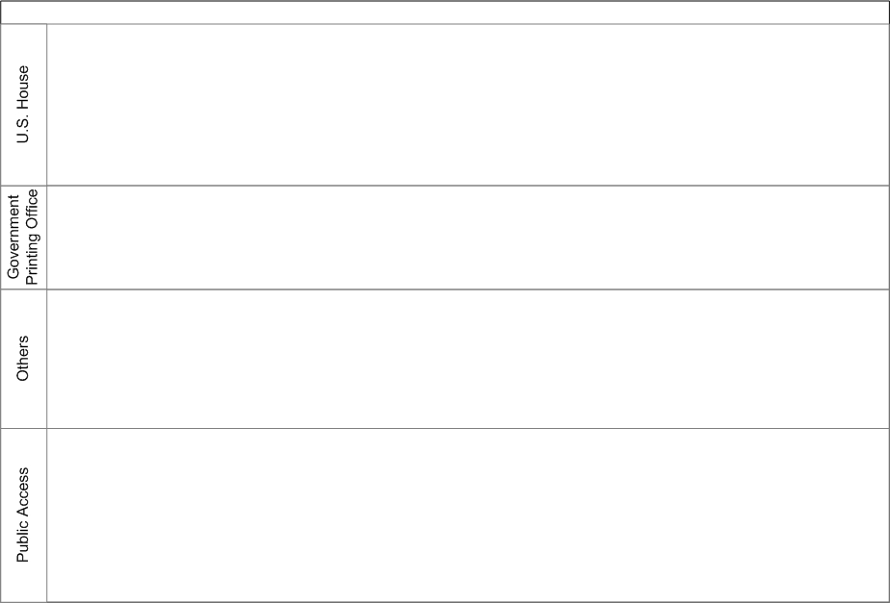
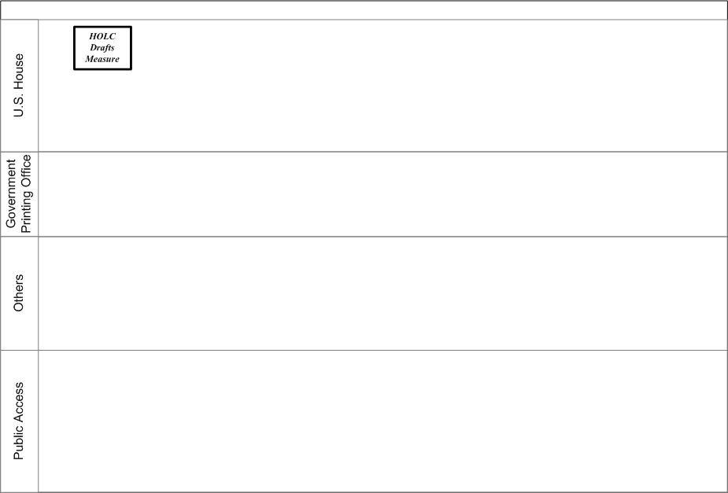
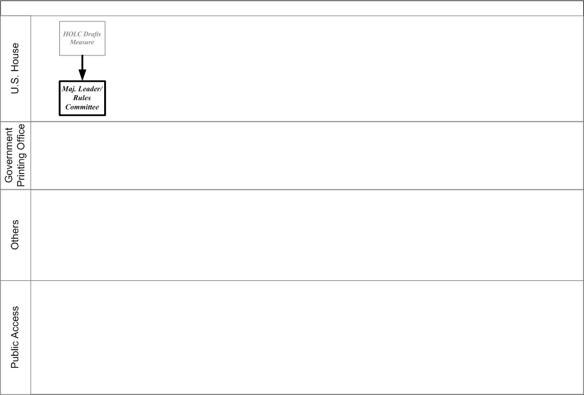
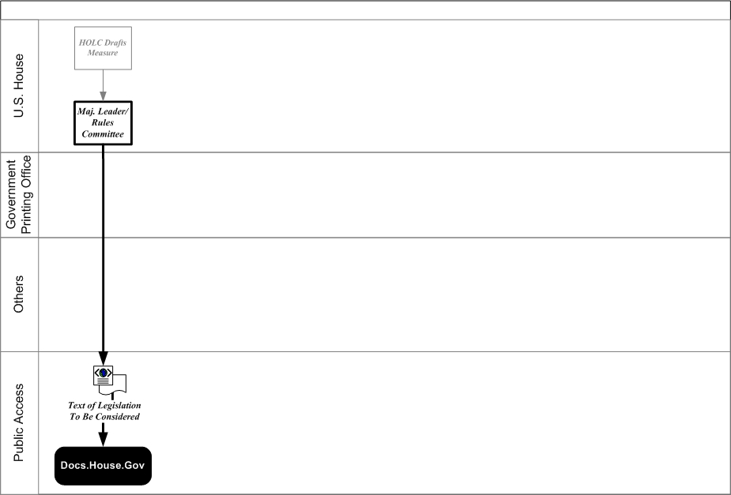
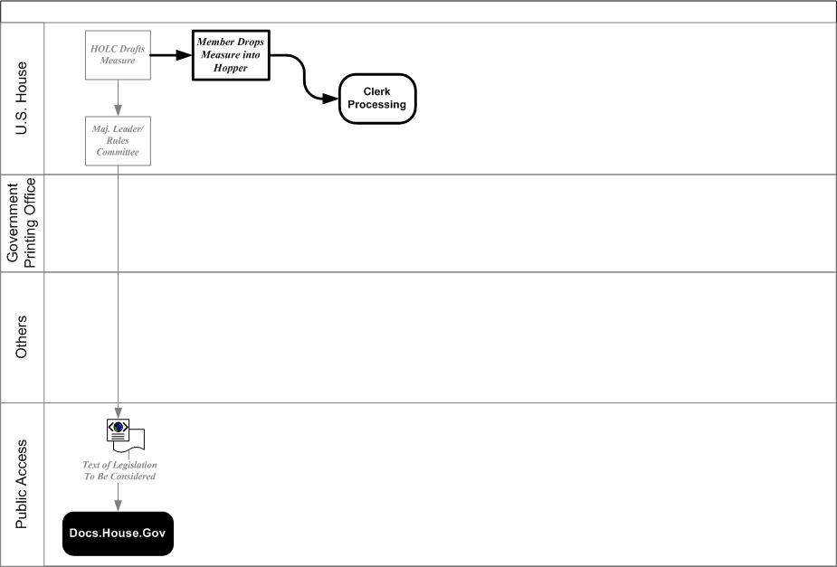
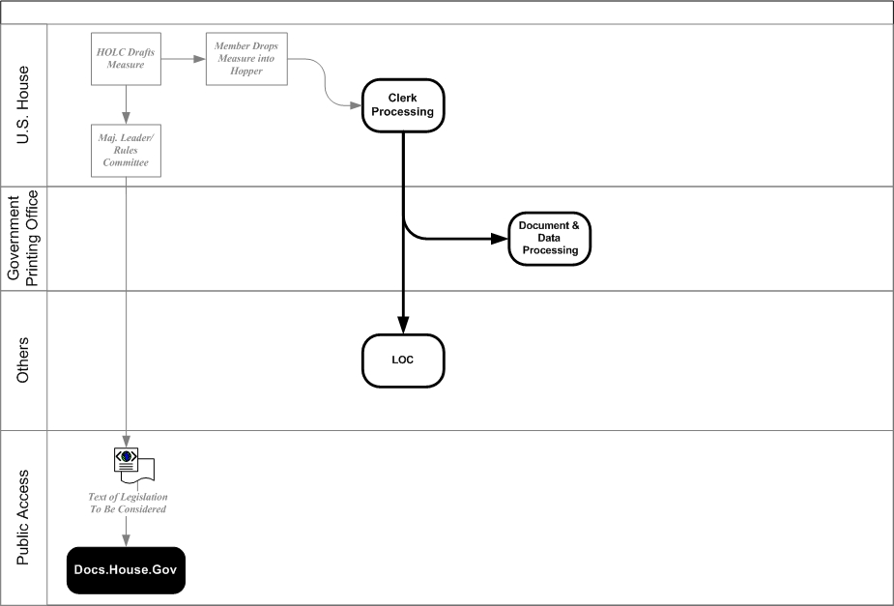
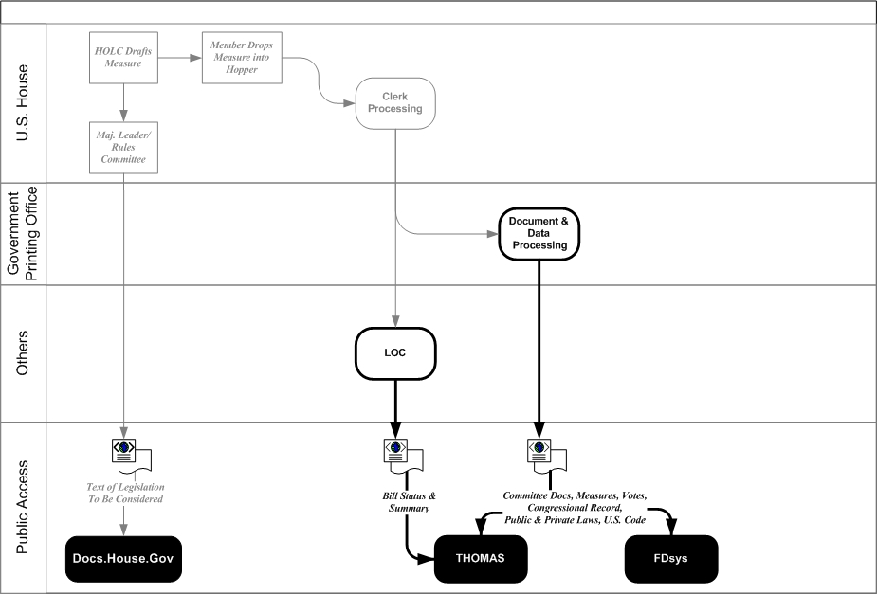
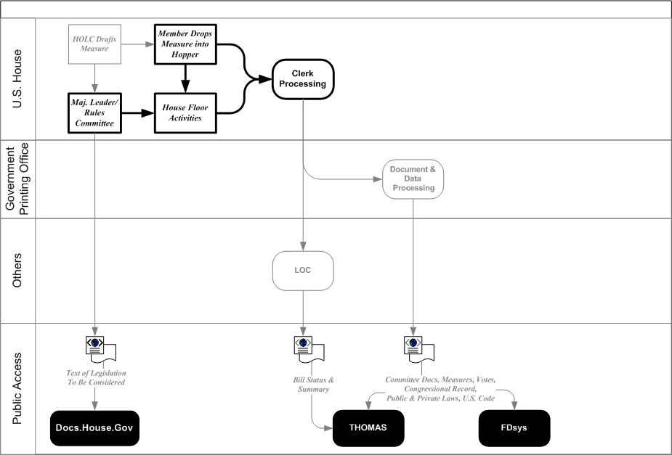
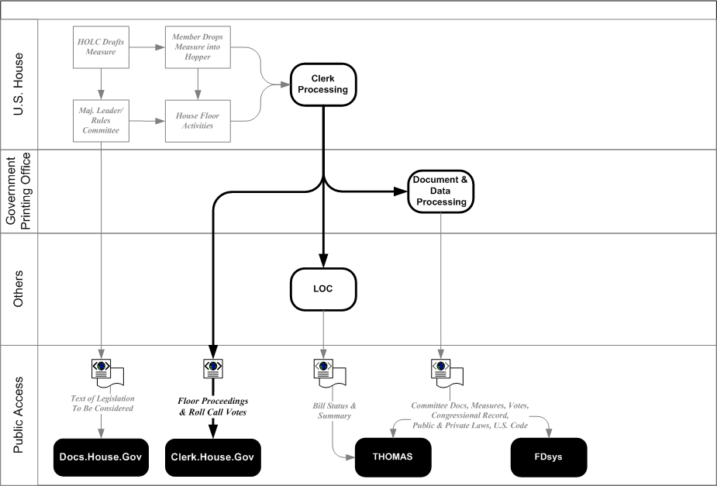

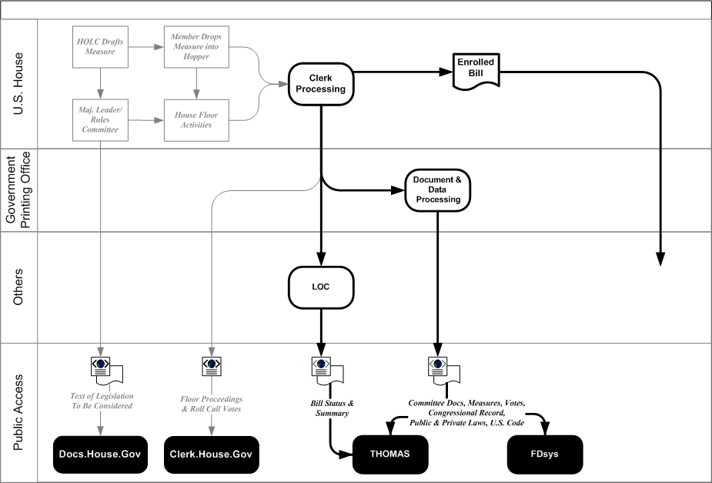
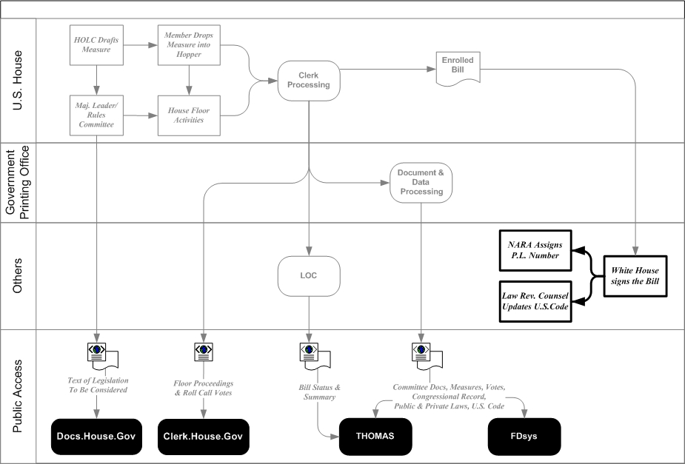

Notes:
New diagram

Slide 8


Slide 9

For more information
XML: http://xml.house.gov

